Slide 1
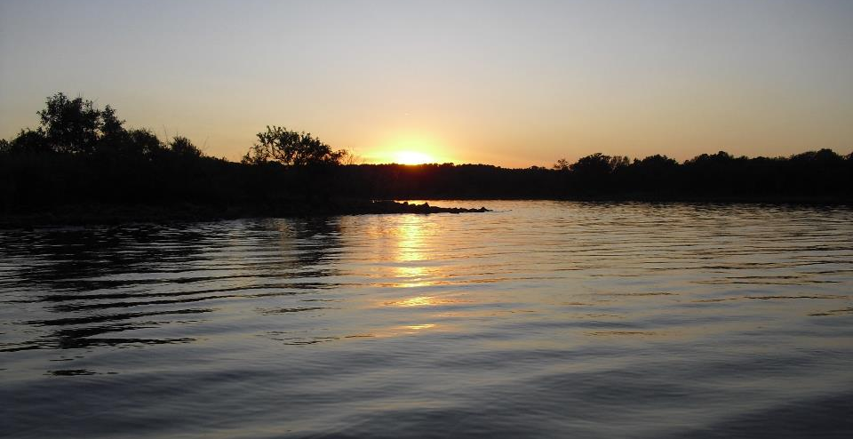
Lab Analysis, Sample Collection and Field QA
GCSA Workshop
OKR04 MCM-3 and Part IV Sampling and Field Methods
Presented by INCOG
Nienhuis Park
May 18, 2022

Slide 2
EPA’s Major Data Quality Indicators
EPA recommends the following criteria to ensure data quality:
Data Quality Indicator | Description / How Used
Precision | The closeness of multiple measurements
Accuracy | The closeness of a measurement to the actual value
Representativeness | The closeness of the actual conditions of a measurement or sample to the intended condition
Completeness | The closeness of the number of measurements or samples actually taken to the number intended
Comparability | The ability to compare results to other results or targets

Slide 3
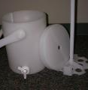
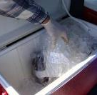
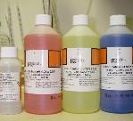
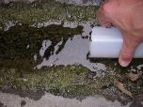
Sampling Considerations Prepare for each field trip
TYPE: Grab vs. composite vs. continuous
DEVICE: Direct fill, sampler, compositor
CONTAINERS: Plastic, glass, specialized
LABELS: Check with lab
PRESERVATION: Part 136 & check with lab
HOLDING TIMES: Part 136 & lab
CHAIN OF CUSTODY: Check with lab
FIELD NOTES & MEASUREMENTS: Forms
INSTRUMENTS: Calibrated, working

Slide 4
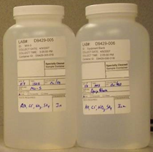
Field Duplicate and Field Split Samples (for precision testing)
A field duplicate is a second sample collected from the same location, the same way and as close to the same time as possible.
Field splits are obtained by dividing one sample into two portions in the field.
Field duplicates and splits indicate precision in the sampling procedures and between different analytical tests / labs.

Slide 5
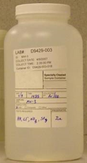
Field Blank Samples (for detecting contamination)
Trip blank - a sample container filled in the lab with pure water, transported to the field with the empty containers and then back to the lab with the samples.
Field blank - a clean sample container filled with reagent water in the field.
Equipment blank - collected by rinsing pure water through the field equipment and filling a sample bottle.

Slide 6
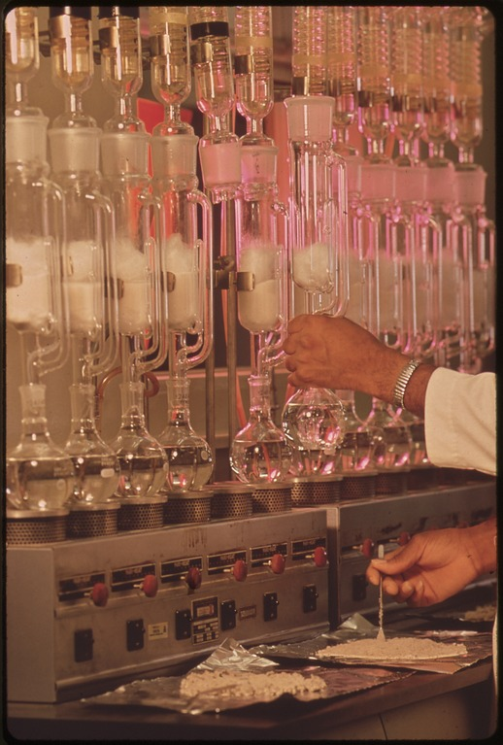
Know Lab and Field QA Terms
Blanks, duplicates, replicates, split, performance tests, calibration checks, etc.
Varies by parameter and type of field or lab test method.
Be familiar with all QA testing terminology and how to interpret the QA data.
Request the types of QA tests to be run by the lab.
The lab may suggest or require certain tests and conditions for its own Part 136 QA.
The lab will tell you the sample volumes needed to run all lab QA tests.
Explain and work with the lab on all QA testing and what QA samples the lab will need to be collected.
This Photo by Unknown Author is licensed under CC BY-SA

Slide 7
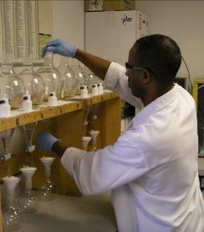
Laboratory Testing Pros and Cons
Lab analysis benefits are:
Greater precision and accuracy
Lower detection limits
Fewer interference problems
Laboratory certification
Highly trained personnel
EPA-based data integrity
Lab disadvantages are:
Longer time to get results
Higher cost
Complex documentation
Budgeting and contracts

Slide 8
40 CFR Part 136 Methods
CFR = Code of Federal Regulations.
Title 40 of CFR (“Protection of Environment”) covers EPA's mission to protect human health and the environment.
40 CFR Part 136 = “Guidelines Establishing Test Procedures For The Analysis of Pollutants”.
§136.1 Applicability.
§136.2 Definitions.
§136.3 Identification of test procedures.
§136.4 Application for and approval of alternate test procedures for nationwide use.
§136.5 Approval of alternate test procedures for limited use.
§136.6 Method modifications and analytical requirements.
§136.7 Quality assurance and quality control.
Notes:
All laboratory analyses, whether for TMDLs or any other sampling done under OKR04, must use 40 CFR Part 136 methods (see OKR04 Part VI.A.2.b).
Let’s dissect the nomenclature. “CFR” refers to Code of Federal Regulations. It’s a way that the federal government “codifies” all of its rules (regulations).
“40” is Title 40 of the CFR which covers “Protection of Environment” codes, including all of EPA’s regulations.
Part 136 of Title 40 of the CFR (referred to as “40 CFR Part 136”), contains the “Guidelines Establishing Test Procedures For The Analysis of Pollutants”.
Part 136 has 7 sub-parts listed in Slide 32 for how these test procedures are laid out, and the next slide lists the 4 Appendices to Part 136.
Part 136 and its appendices can be downloaded from the internet, most always by sub-parts. The entire set of documents is over 200 pages in length.

Slide 9
40 CFR Part 136 Appendices
Appendix A to Part 136—Methods for Organic Chemical Analysis of Municipal and Industrial Wastewater
Appendix B to Part 136—Definition and Procedure for the Determination of the Method Detection Limit—Revision 2
Appendix C to Part 136—Determination of Metals and Trace Elements in Water and Wastes by Inductively Coupled Plasma-Atomic Emission Spectrometry Method 200.7
Appendix D to Part 136—Precision and Recovery Statements for Methods for Measuring Metals
Notes:
Part 136 is a collection of laboratory procedures that have been approved for analysis of water samples by EPA and other agencies and organizations.
Demonstrated effective use of Part 136 methods is required for a laboratory to become certified by DEQ.
Most of the methods in Part 136 deal with the many types of analytical procedures of organic compounds, but inorganic and biological methods are also included.
40 CFR Part 136 has some basic QA requirements, but each method cited in Part 136 must be consulted to learn of all QA requirements applicable to that method.
Fortunately, all DEQ certified laboratories will help clients meet all Part 136 QA requirements without the client having to research the QA requirements themselves.

Slide 10
Example of Part 136 QA Procedures
Appendix A to Part 136—Methods for Organic Chemical Analysis of Municipal and Industrial Wastewater
Method 601—Purgeable Halocarbons
NOTE 9. Sample Collection, Preservation, and Handling
9.1 All samples must be iced or refrigerated from the time of collection until analysis. If the sample contains free or combined chlorine, add sodium thiosulfate preservative (10 mg/40 mL is sufficient for up to 5 ppm Cl₂) to the empty sample bottle just prior to shipping to the sampling site. EPA Methods 330.4 and 330.5 may be used for measurement of residual chlorine.⁸ Field test kits are available for this purpose.
9.2 Grab samples must be collected in glass containers having a total volume of at least 25 mL. Fill the sample bottle just to overflowing in such a manner that no air bubbles pass through the sample as the bottle is being filled. Seal the bottle so that no air bubbles are entrapped in it. If preservative has been added, shake vigorously for 1 min. Maintain the hermetic seal on the sample bottle until time of analysis.
9.3 All samples must be analyzed within 14 days of collection.³
Notes:
As an example of method-specific QA, this slide lists some of the specific QA that must be followed, in this case, for using Method 601 for Purgeable Halocarbons.
Note 9 in Method 601 covers “Sample Collection, Preservation and Handling” which is a category of QA repeated in most Part 136 methods.
In this case, to sample for Purgeable Halocarbons, the collected sample must be stored on ice or refrigerated from the time of initial collection to the time of lab analysis.
The “grab samples” (we will cover this in the future) must be collected in glass containers with a minimum of 25 mL volume and no trapped air bubbles.
The sample bottle must be sealed and shaken vigorously for 1 minute if a preservative is added. All samples must be analyzed within 14 days of collection.
These are just a few of the many QA-related sample collection and processing requirements in Method 601, and all Part 136 methods have similar QA details.

Slide 11
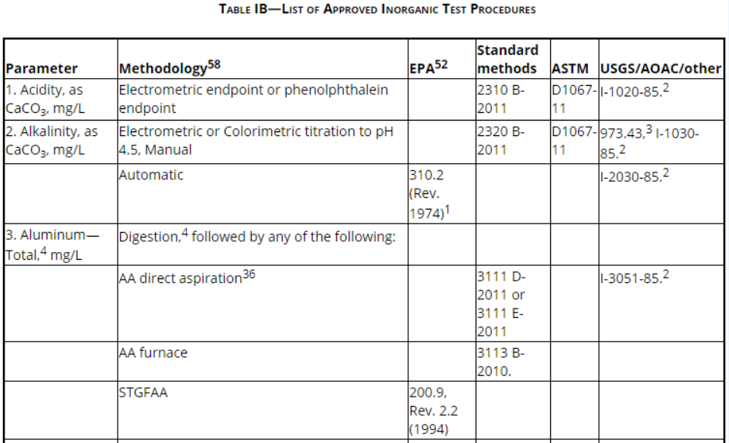
Example of Part 136 Approved Tests
Notes:
This slide shows a small portion of one of the tables in Part 136 that lists pre-approved lab methods for analysis of water samples.
For example, 3 types of “Methodology” (lab test methods) are approved for analysis of Total Aluminum after sample digestion: AA Direct Aspiration, AA Furnace and STGFAA.
If the lab and client agree that Total Aluminum should use AA Direct Aspiration, there are 3 method options: 2 under Standard Methods and one under USGS/AOAC/Other.
Under Standard Methods (a large book of test methods), the Part 136 approved test procedures are: Method 3111 D-2011 and Method 3111 E-2011.
Under the USGS column, the Part 136 approved test method is I-3051-85.
All this may seem daunting, and it can be confusing for MS4s that are just beginning to delve into selecting certified labs and using Part 136 methods.
The good news is that all DEQ certified laboratories already know Part 136 inside and out, and they have set up their programs to help their clients.
Labs become your sampling partner. They will help select the best Part 136 methods for your project and provide all containers, preservatives, sampling instructions and paperwork.

Slide 12

Coordinate With the Laboratory
Know the laboratory hours and how late they will receive samples before going into the field.
Know how many samples the laboratory can process within required holding times.
Check with the laboratory before going out to make sure their instrumentation and required personnel will be available to perform the analysis you need.

Slide 13

Coordinate With the Laboratory
Make sure all parties are clear on:
Who will supply sample bottles, preservatives, etc.
The volumes of samples required
Any special requests (e.g., certain analytical methods and rush requirements
Sampling and lab schedules (date, time)
Laboratories usually close evenings and weekends. Don’t miss sample holding times.

Slide 14

Laboratory Contracts
Most MS4s will have to seek bids and execute contracts or written agreements for lab services.
The lab agreement should include items such as:
Lab is certified for all parameters and test methods.
Parameters to be analyzed and methods to be used.
Sample delivery dates and times to the lab.
Lab preservation and processing requirements.
Any preferences for lab report contents and QA tests.
Test detection limits and significant figures issues.
Contacts for questions and problem resolution.
Breakdown of costs, invoicing and payment procedures.

Slide 15
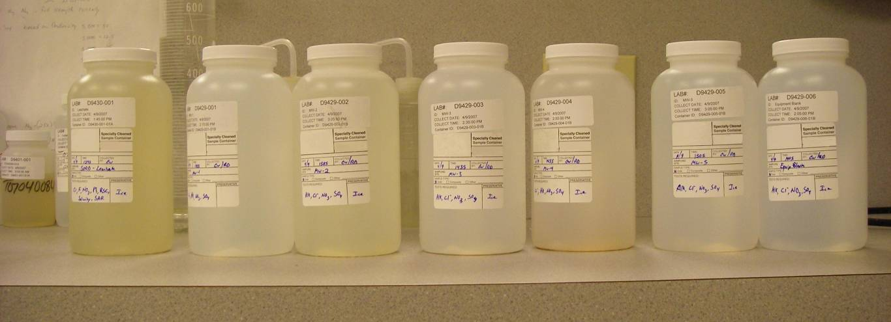
Labels For Sample Containers
City / MS4 Name
Sample date and time
Site name and code number
Preservative
Names of field crew members
Parameter(s) for analysis
Use waterproof labels & ink
City of Sand Springs
November 11, 2022
Polecat Creek Site PC-3
HNO₃ at 4 ºC
Jane Smith / Bob Jones
Metals (lead, copper, zinc, cadmium)
EXAMPLE

Slide 16
Chain of Custody Form Example
Collector: |  |  |  | Date Sampled:
Address: Phone:
Project: |  |  |  | Project #:
Analyses Requested: (Arranged by present contract).
LAB SAMPLE NUMBER | CITY SAMPLE NUMBER | CONTAINER P / G | PRESERVATIVE | FIELD INFORMATION
1
2
3
4
5
6
7
8
Relinquished By: Date / Time: |  |  | Accepted By: Date / Time:
Relinquished By: Date / Time: |  |  | Accepted By: Date / Time:
Relinquished By: Date / Time: |  |  | Accepted By: Date / Time:
Relinquished By: Date / Time: |  |  | Accepted By: Date / Time:

Slide 17

Sample Holding Times
40 CFR Part 136 specifies holding times for each parameter.
Sample holding time is the maximum time between sample collection and start of the analysis.
Sample composition can change over months, days, hours or even minutes.
Preserving samples extends holding times.
Some parameters are better analyzed onsite due to short holding times (e.g., temperature, pH, chlorine and DO).

Slide 18

Defensible QA Sample Procedures (Part 136)
Keep updated QAPP, SOPs and written procedures.
Use proper sampling equipment and methods.
Preserve the sample in proper collection bottles.
Collect enough volume of sample for all lab needs.
All sampling should be representative.
Label samples legibly as the lab requires.
Deliver samples to the lab to meet holding times.
Allow time for lab to process and set up samples.
Use a lab-approved chain of custody form.

Slide 19
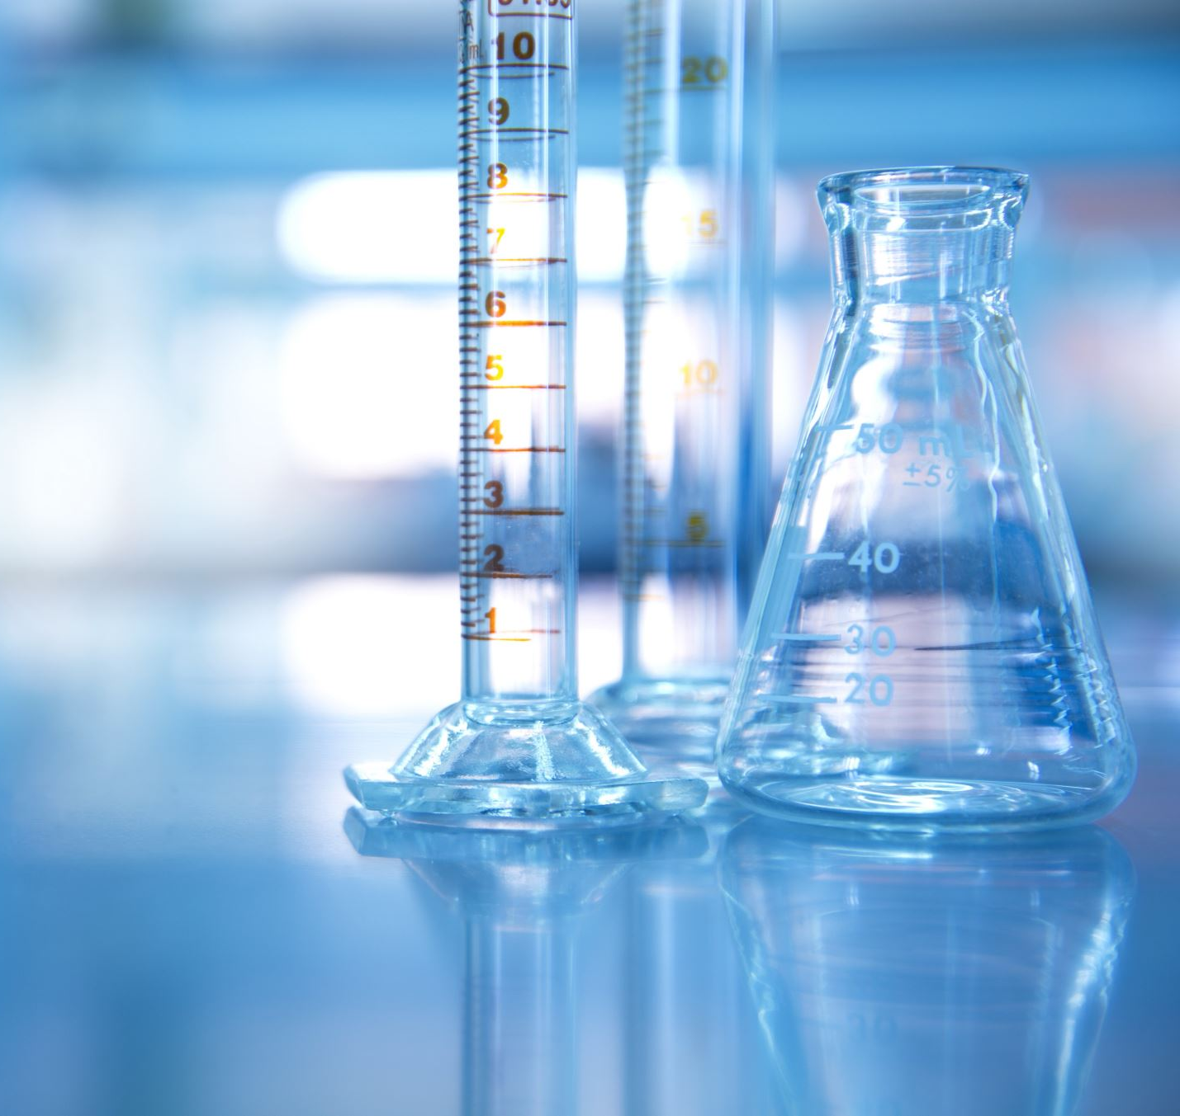
Reviewing Lab Reports
Compare the lab report and Chain of Custody for correctness.
Review the general laboratory information correctness.
Verify that the correct tests and methods were used.
Verify that holding times were met.
Verify that all QA procedures and tests were acceptable.
Verify that all parameters’ reporting units are correct.
Verify that the invoice amount and payments are correct.
Contact the lab if you have any questions about test results or any information in the report you do not understand.

Slide 20

MS4 Recordkeeping
Copies of permits, NOIs, DEQ letters, etc.
Stormwater Management Program (SWMP)
Quality Assurance Project Plan (QAPP)
Standard Operating Procedures (SOPs)
Chain of Custody Forms (CoC)
Lab and field data with all QA data and notes
Instrument calibration and maintenance logs
Stormwater program Work Orders and files
Technical data, maps, documents, photos, communications

Slide 21
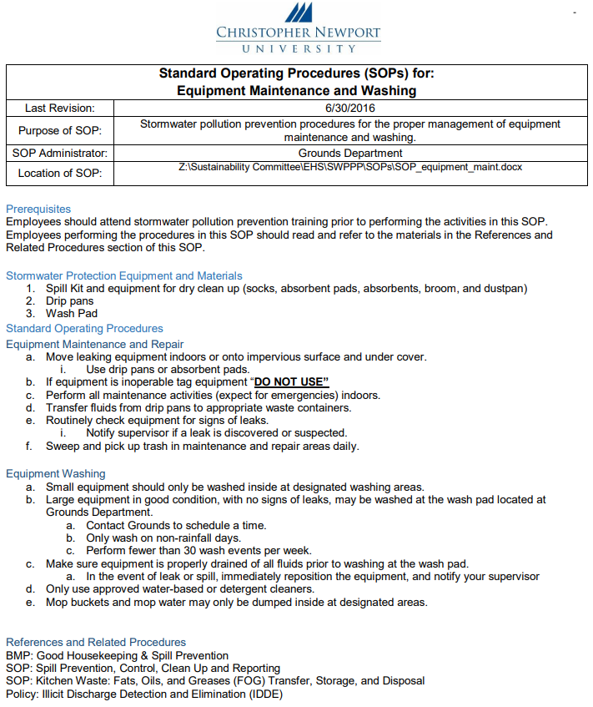
SOP Content Considerations
Scope & Application
Summary of Method
Health & Safety Warnings
Analytical Interferences
Personnel Qualifications
Equipment & Supplies
Sample Collection Methods
There are many types of SOPs:
Template sources (OCC, OWRB, DEQ, etc.)
Content details, formatting, arrangement
OKR04 does not require SOPs.
OKR04 does require “plans” and “procedures”.
MS4s can use any SOP style.
SOPs must be concise and effective.
Analytical Procedures
Calculations
Data & Records Management
QA / QC Requirements
Maintenance & Calibration
References & Definitions
Contact Information

Slide 22



Questions ?
Vernon Seaman
Manager, Envir. And Energy Planning
INCOG
Two West 2nd Street, Ste 800
Tulsa, OK 74103
(918) 579-9451
vseaman@incog.org

